Slide 1

Concurrency: Reactive vs Shared State
Benchmarking Akka actors against shared-state concurrency
June 17th, 2015

Slide 2

ABOUT ME | DANA PEELE, SR APPLICATION DEVELOPER
Developer
Rock climber
Dad
Scala junkie

Slide 3

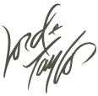


Four E-commerce banners
NOT an agency
Strong engineering culture
Incredible stacks
Scala/Play/Akka/Mongo
React/Backbone/Marionette

Slide 4
Concurrency
Multiple threads executing simultaneously
Our example- an inventory web service with multiple clients making requests in parallel
Challenge- ensure that we don’t sell inventory we don’t have
Inventory Web Service

Slide 5
Options to Handle Concurrency
Shared-State
Akka (Reactive)
Other:
Function Reactive Programming (Not the same as Reactive)
Publisher/Subscriber
CSP
STM

Slide 6
Shared-State
Shares mutable state across threads
Uses locks/synchronized blocks to prevent race conditions
Proven and well understood
In widespread use for a long time
Simple to reason about for trivial applications
Complex applications are very difficult to model
Thread sleep/awake is expensive
Deadlocks!

Slide 7
Akka (Reactive)
Actors instead of threads
Lightweight, easy to reason about (actor’s are like people… specialized and one task at a time), delegate and supervise
Actors communicate with message passing
Messages are objects containing information, they aren’t imperative, they’re reacted to
Mutable state
But only an actor can change itself (state isn’t shared)
Each actor has a mailbox (queue)
Synchronous message processing (No locks, blocking, or thread sleep)
Loose coupling
Messages are strongly typed, receive method that processes them isn’t
Requires care in modeling and refactoring to ensure resiliency and performance
Dangerous tasks and mutable state don’t mix and require supervision, can’t multithread mutation

Slide 8
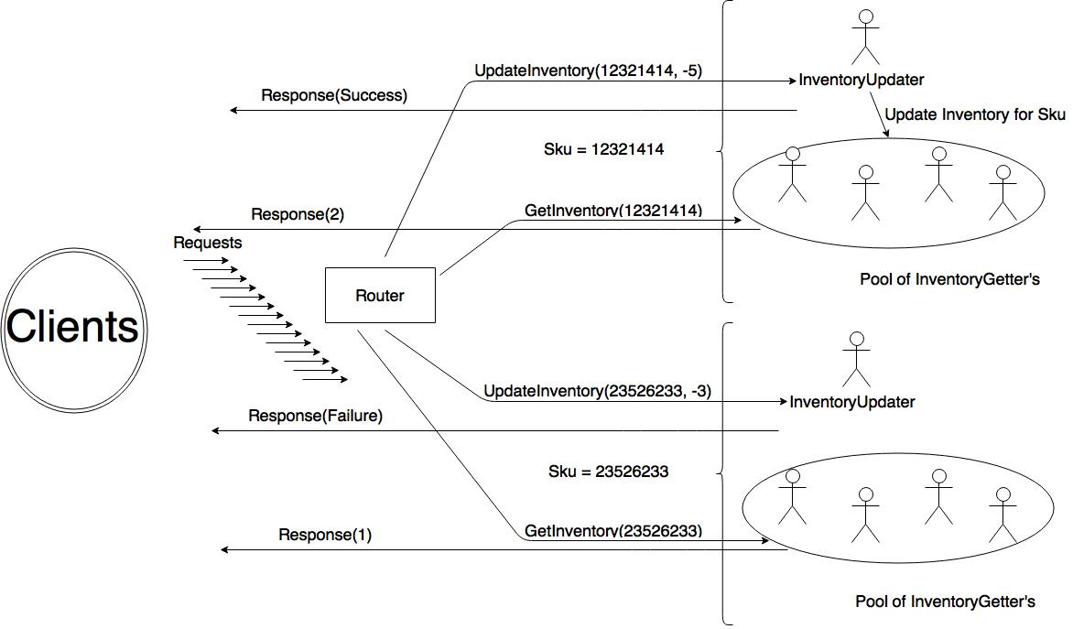

Slide 9
DevOps
At HBC we are using
Kitchen (testing)
Vagrant (virtual machines)
Puppet (provisioning)
Librarian Puppet (more provisioning)
Docker (containers)
We practice Infrastructure as code
versioning
pull requests
code review
regression testing
reproducibility
Linux base box
Puppet Librarian
to source modules for SBT, Java, MongoDB, and Docker
Installed in my base box (provision)
spin up and deploy a Docker container running StatsD and Graphite
Run Play applications with SBT and Java while running MongoDB, StatsD, and Graphite instances ready to use.
Notes:
Right column is Dev Ops used in this demo. Now let’s look at code!!!

Slide 10
Inventory Applications- Shared Elements
Play web framework
Built on Akka
Netty, a non-blocking I/O client-server framework (Originally developed by JBoss)
Incorporates logging and configuration management
Reactive mongo
Non-blocking, asynchronous driver built on Akka Streams.
Database ops return an immediately future and (may) eventually complete
Metrics
StatsD (aggregator) Data received via one-way udp protocol, sends to Graphite
Graphite- Dashboard web application

Slide 11
Shared-State Inventory Application
Application controller
TrieMap of InventoryQuantity instances keyed to product sku (id)
val inventory = TrieMap[String, InventoryQuantity]()
val r = scala.util.Random
for (sku <- 1 to 100) {
val quantity = r.nextInt(10000) + 10000
inventory.put(sku.toString, new InventoryQuantity(quantity))
mongoRepo.setInventory(sku.toString, quantity)
}
Handler methods
getInventory
updateInventory
Persists the new value to Mongo if quantity changes
Both handler methods respond to the request and then send out our metrics.

Slide 12
Shared-State: updateInventory handler
def updateInventory(sku: String, quantityChange: Int) = Action.async ({
request =>
val startTime = System.currentTimeMillis
val f = Future {
Logger.debug("update inventory called")
val skuInventoryOption = inventory.get(sku)
var result = NotFound(Json.toJson(InventoryResponseModel("update", sku, success = false, 0, "sku not found")))
skuInventoryOption match {
case Some(skuInventory) =>
val response = skuInventory.updateQuantity(quantityChange)
result = Ok(
Json.toJson(
InventoryResponseModel(
"update", sku, success = response._1, quantityChange, if (!response._1) s"Only ${response._2} left" else ""
)))
response._1 match {
case true => mongoRepo.setInventory(sku.toString, response._2)
case _ =>
}
case _ =>
}
result
}
f.onComplete({case _ =>
statsDSender ! SendTimer("shared-state.update.duration", System.currentTimeMillis - startTime)
statsDSender ! IncrementCounter("shared-state.update.count")
})
f
})
}

Slide 13
Shared-State: InventoryQuantity Model
InventoryQuantity model
Dirty reads but synchronized writes using a lock.
def updateQuantity(quantityUpdate: Int): (Boolean, Int) = {
var returnValue: (Boolean, Int) = (false, quantity)
writeLock.lock()
quantityUpdate >= 0 || quantity + quantityUpdate >= 0 match {
case true =>
quantity += quantityUpdate
returnValue = (true, quantity)
case _ =>
}
writeLock.unlock()
returnValue
}

Slide 14
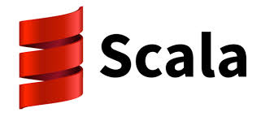



Q&A

Slide 15
Obligatory We Are Hiring Slide
Surprise! We are hiring.
Follow us:
Twitter: @HBCDigital
LinkedIn: https://www.linkedin.com/company/hbc_digital?trk=biz-companies-cym
Contact Info:
dana_peele@s5a.com
@Dana_S_Peele
Repo for the demo and slideshow:
https://github.com/saksdirect/react-vs-shared-state-inventory

